Slide 1
FACE DETECTION AND RECOGNITION FOR CRIMINAL IDENTIFICATION SYSTEM

Slide 2
Criminal Identification
Under the Guidance of : A. Sravanthi
Done By :
Haleema Khatun (22U11A0533)
A. Jyoshna (22U11A0505)
D. Varun Laxmi Narasimha (22U11A0525)
Palle Rani (22U11A0557)

Slide 3
CONTENTS
Abstract
Existing System And Proposed System
System Configuration
Literature Survey
System Architecture
Modules
Advantages and Disadvantages
UML Diagrams
Templates
Conclusion

Slide 4
Abstract
The process of identifying and spotting a criminal is slow and difficult. Criminals, these days are getting smarter by not leaving any form Of biological evidence or fingerprint impressions on the crime scene.
With the advancement in security technology, CCTV cameras are being installed at most Of the buildings and traffic lights for surveillance purposes. The video footage from the camera can be used to identify suspects, criminals, runaways, missing persons etc.
Blockchain ensures that all facial recognition data, processing logs, and identification matches are stored in an immutable and tamper-proof ledger. The combination of AI-driven facial recognition with blockchain’s decentralized trust model offers a robust, scalable, and secure solution to modern criminal identification, paving the way for more efficient and reliable law enforcement practices.

Slide 5
Existing System
Existing System
Aspect | Description
Criminal Identification | Manual and time-consuming, relying on physical evidence like fingerprints or eyewitness reports.
Crime Scene Evidence | Criminals often leave no biological traces, making identification difficult.
Surveillance Usage | CCTV footage exists but is underutilized or processed manually, slowing investigations.
Technology Level | No or limited use of automation, AI, or machine learning in existing law enforcement systems.
Challenges | Delay in identifying criminals, increased workload on police, and higher chances of missed identifications.

Slide 6
Proposed System
Aspect | Description
Objective | Automate criminal identification using face detection and recognition powered by machine learning and deep neural networks.
Technology Stack | Python (3.10), Django (Backend), MySQL (Database), HTML/CSS/JavaScript (Frontend), using ML/DNN models.
Hardware | Modern hardware (e.g., i3 5th Gen CPU, 4GB+ RAM, 500GB HDD) supports real-time processing and training models.
Surveillance Integration | Leverages existing CCTV cameras at buildings, traffic lights, and public places for real-time monitoring.

Slide 7
System Configuration
Software Requirements
Operating System | Windows 10/11
Development Software | Python 3.10
Programming Language | Python
Domain | Machine Learning
Integrated Development Environment (IDE) | Visual Studio Code
Front End Technologies | HTML5, CSS3, Java Script
Back End Technologies or Framework | Django
Database Language | SQL
Database (RDBMS) | MySQL
Database Software | WAMP or XAMPP Server
Web Server or Deployment Server | Django Application Development Server
Design/Modelling | Rational Rose

Slide 8
System Configuration
Hardware Requirements
MINIMUM (Required for Execution) |  | MY SYSTEM (Development)
System | Pentium IV 2.2 GHz | i3 Processor 5th Gen
Hard Disk | 20 Gb | 500 Gb
Ram | 1 Gb | 4 Gb

Slide 9
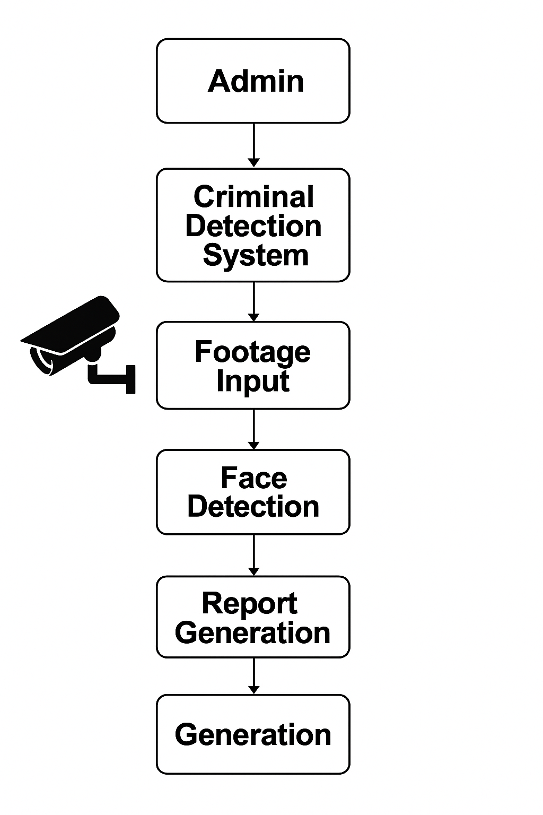
System Architecture

Slide 10
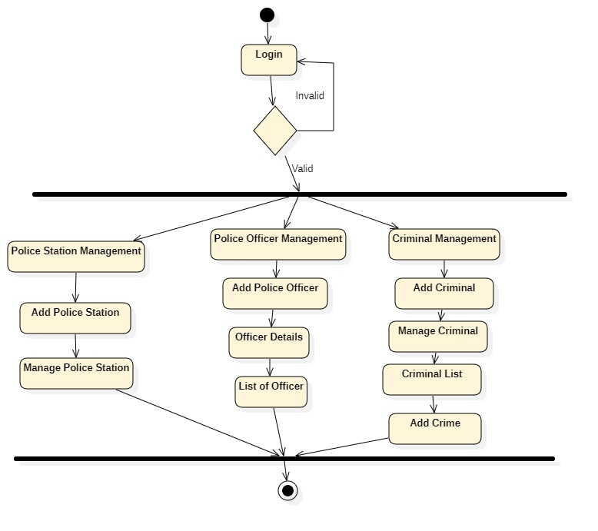
Modules
ADMIN :
Login
Police Station Management
Add Police Station
Manage Police Station
Police Officer Management
Add Police officer
Officer Details
Add Criminal
Manage Criminal
Criminal List
Add Crime
Logout

Slide 11
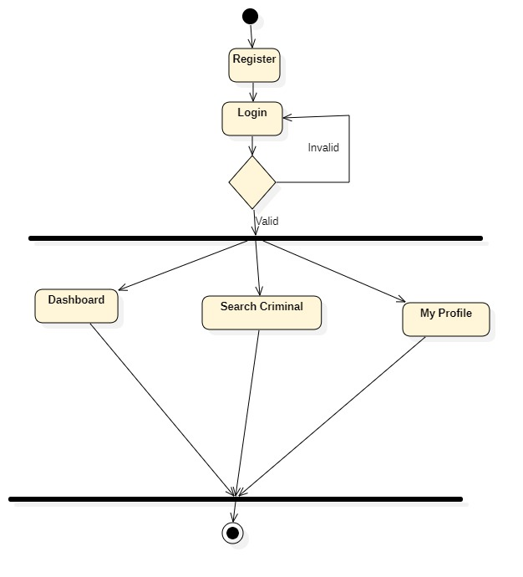
Modules
USER:
Register
Login
Dashboard
Search Criminal
My Profile
Logout

Slide 12
Advantages
Real-time Surveillance Integration
Works seamlessly with live CCTV footage to detect and recognize faces instantly.
Higher Accuracy with Deep Learning
Utilizes machine learning and deep neural networks for improved detection accuracy and face matching.
Non-Invasive and Contactless
Does not require physical contact or biometric input from suspects, enhancing safety and ease of use.
Enhanced Law Enforcement Capability
Provides police with an advanced tool to identify criminals, suspects, and missing persons swiftly.
Data Centralization
Consolidates criminal data (photos, details, history) in a central MySQL database, making access and management easier.

Slide 13
Disadvantages
Privacy Concerns
Continuous surveillance and face recognition can raise ethical and legal concerns regarding personal privacy.
False Positives/Negatives
The system may incorrectly identify individuals due to lighting, angle, poor image quality, or similar facial features.
Dependency on Quality CCTV Feeds
Accuracy heavily depends on the resolution and positioning of CCTV cameras; low-quality footage can hinder recognition.
Data Security Risks
If not properly secured, criminal databases and personal information could be vulnerable to cyberattacks or leaks.
High Initial Setup Cost
Requires investment in hardware (CCTV, servers) and software development (ML models, databases).

Slide 14
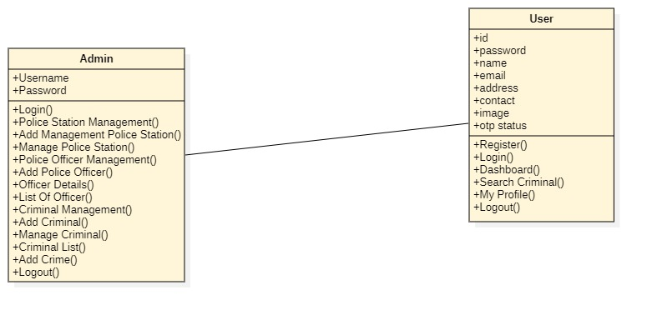
UML Diagrams Class diagram

Slide 15
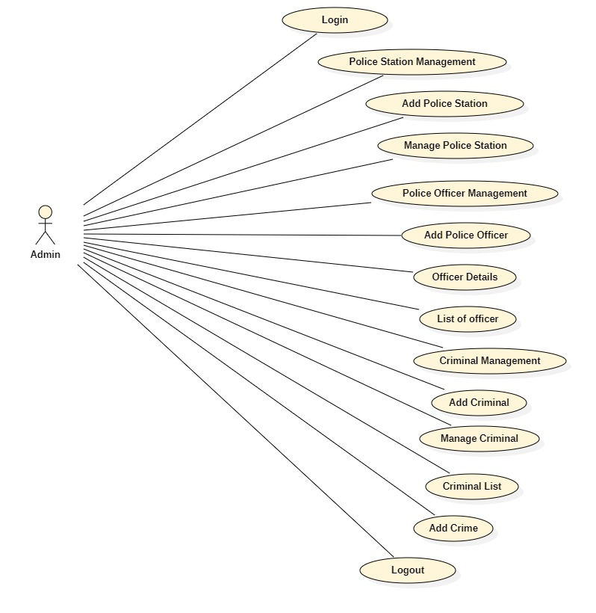
Use case diagram

Slide 16
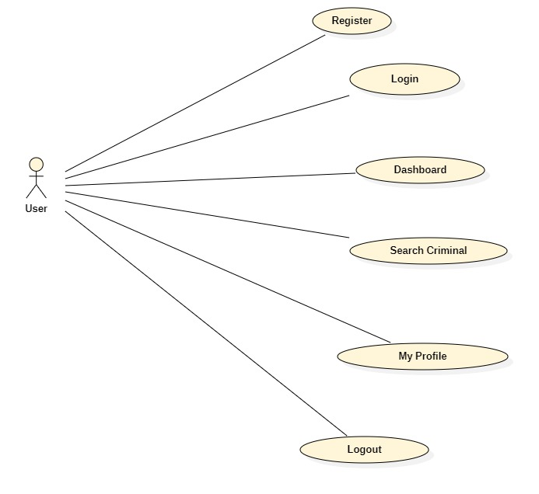
Use case diagram

Slide 17
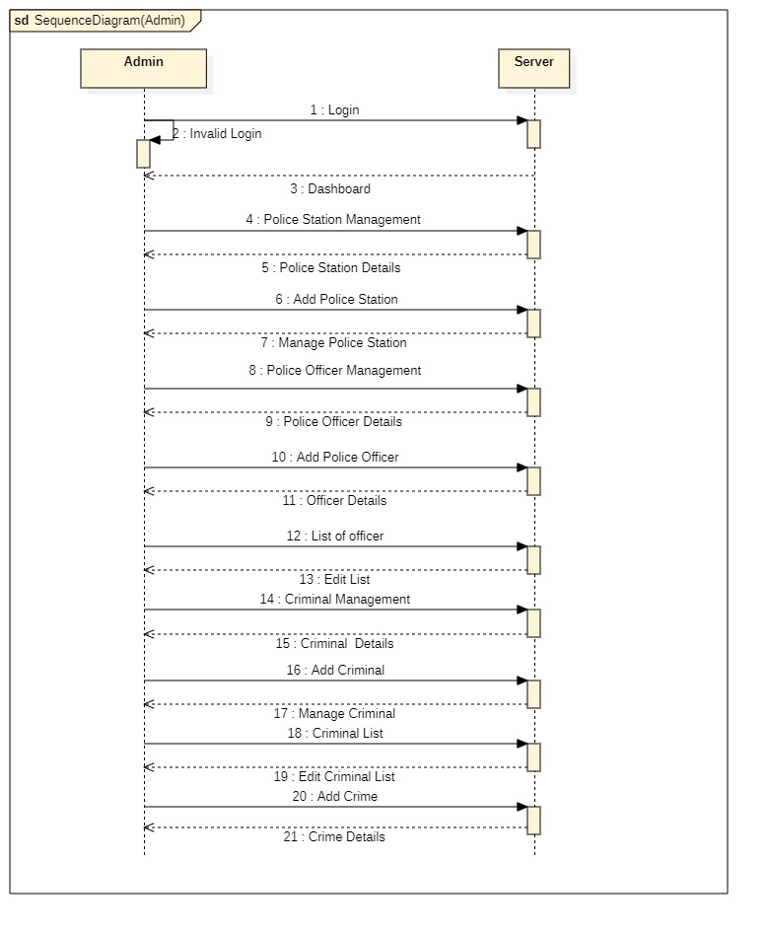
Sequence diagram

Slide 18
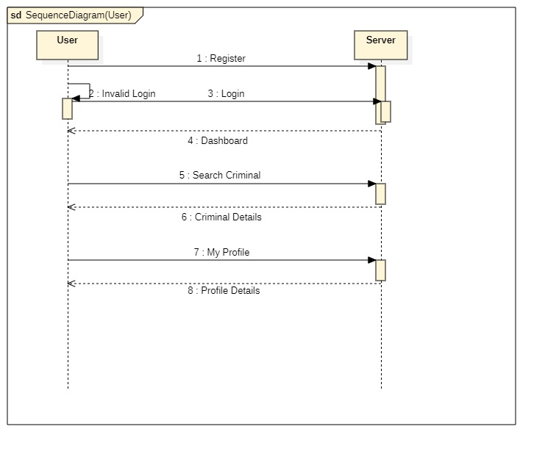
Sequence diagram

Slide 19

Templates Main screen

Slide 20


Output screen for loading data

Slide 21


Output screen for loading data

Slide 22
Conclusion
The integration of machine learning-based facial recognition with blockchain technology presents a transformative approach to modern criminal identification. By leveraging deep neural networks, the system can efficiently analyze surveillance footage and accurately identify individuals of interest. The incorporation of blockchain adds a critical layer of security, ensuring that all data and transactions are immutable, transparent, and resistant to tampering. This dual-technology framework not only streamlines the investigative process for law enforcement agencies but also upholds the integrity and accountability of sensitive data. Ultimately, this system represents a significant step forward in creating a smarter, more secure, and more effective public safety infrastructure.

Slide 23

THANK YOU

